Slide 1
CONSTRUCTION COMMUNICATION PROGRAM
Mailer One
Mailer Two
Two weeks prior to construction start residents receive a letter
One week prior to start, residents receive a postcard
Door Hangers and Yard Signs
Sandwich Board
During construction, contractor places sandwich board at neighborhood entrances each day
Three to five days prior to start, contractor places door hangers and yard signs
Dedicated toll-free number for construction
Calls directly to triage team
Passed on to correct resource
NOTE: Construction toll-free number and website URL are on all forms of communication

Slide 2
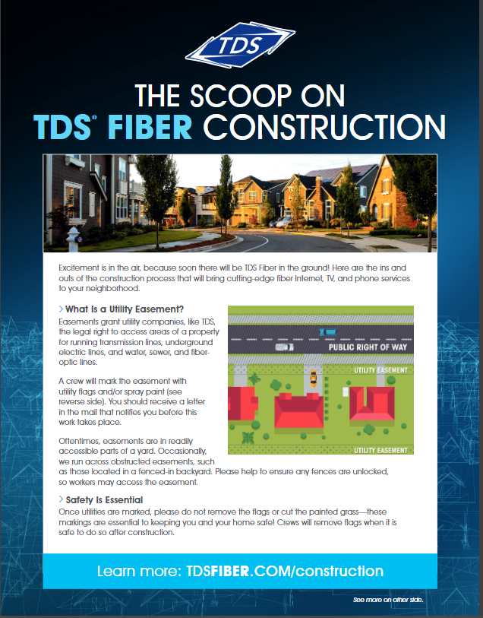


CONSTRUCTION COMMUNICATION PROGRAM
Mailer 1
14 days
Letter answers common questions around construction, explains construction process, and sets expectations of what residents will receive for construction notification communication.
Notes:
Letter answers common questions around construction. Sets expectations of what residents will receive for construction notification communication.

Slide 3
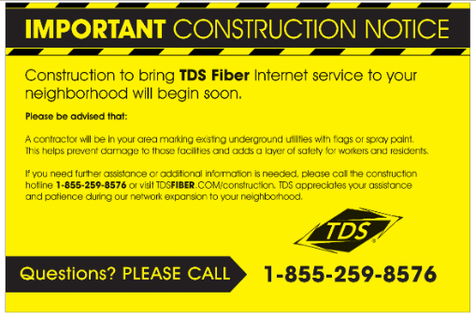
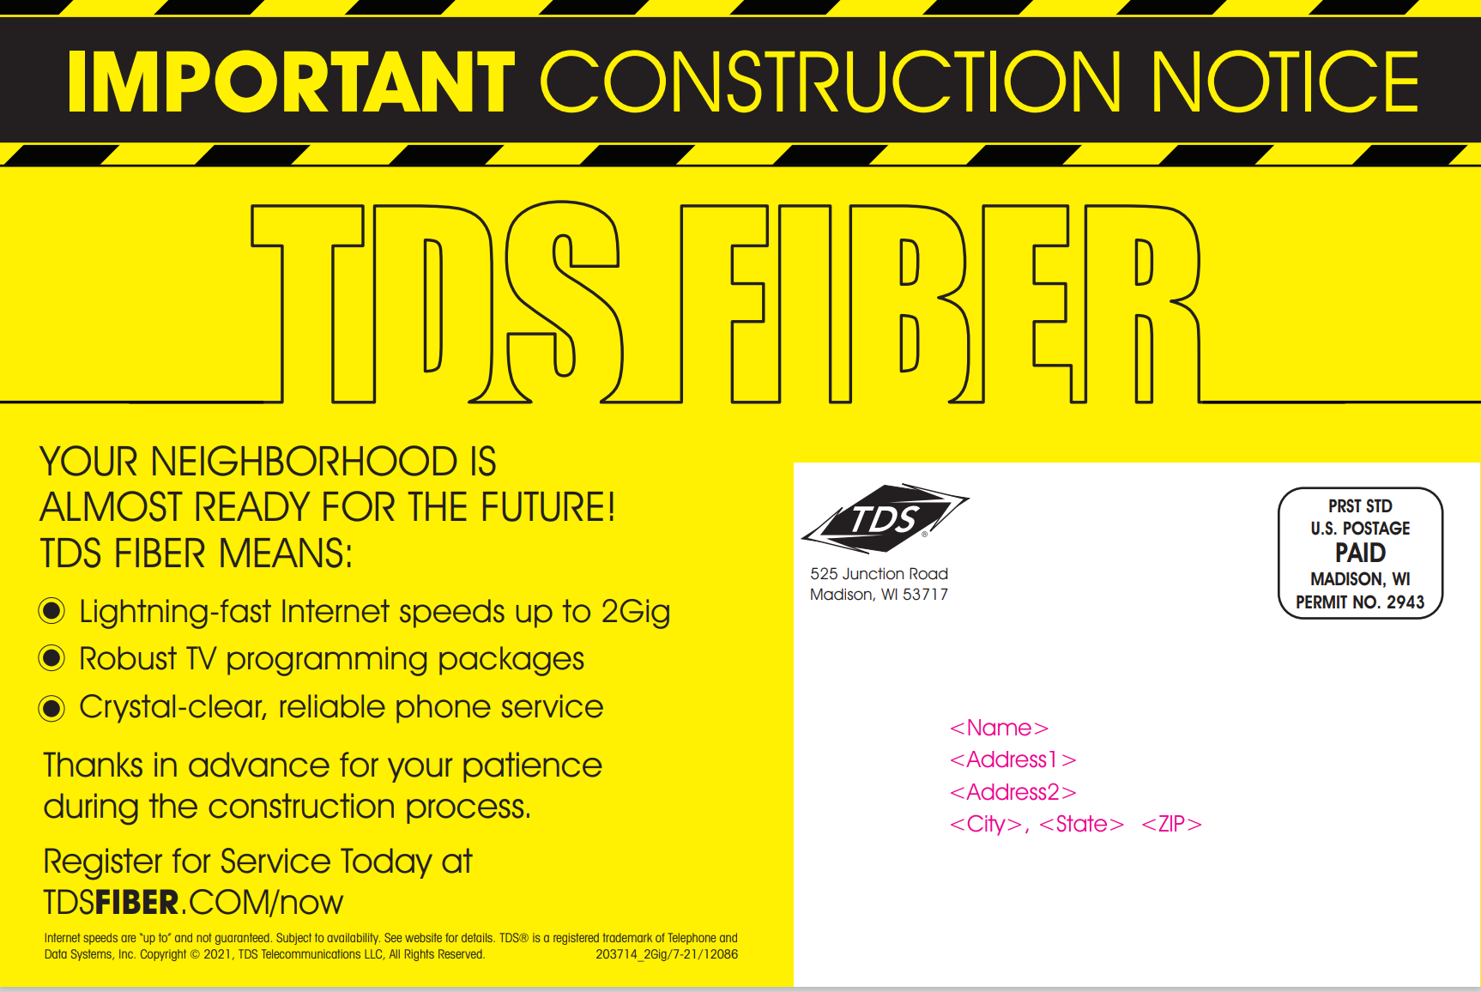
CONSTRUCTION COMMUNICATION PROGRAM
Mailer 2
7 days
Postcard provides notice that contractors will be in the area

Slide 4
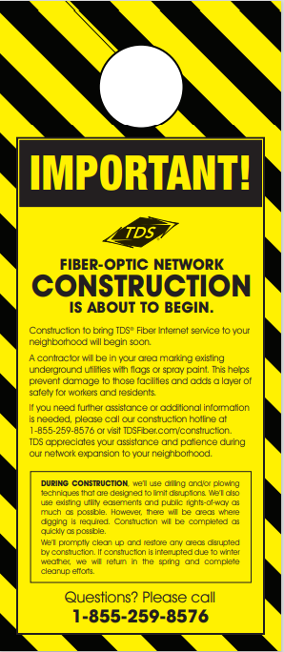


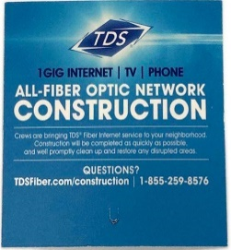

CONSTRUCTION COMMUNICATION PROGRAM
Door Hanger and Yard Sign
3 - 5 days
Contractors place door hangers and yard signs to notify residents that contractors will be in the area

Slide 5
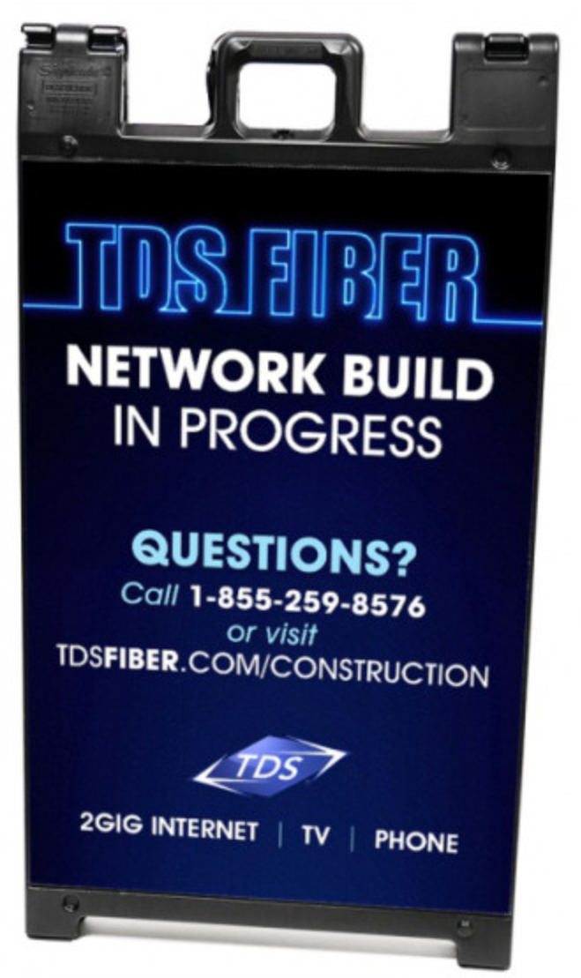

CONSTRUCTION COMMUNICATION PROGRAM
Sandwich Board and Contact Us Cards
Daily
Contractors must place sandwich boards at entrance of neighborhoods each day. They will also hand out business cards with contact information if residents have further questions.

Slide 6

CONSTRUCTION COMMUNICATION PROGRAM
Vehicle Signage
Daily
Contractor vehicles will display a TDS contractor decal on days they are representing TDS and performing construction.

Slide 7
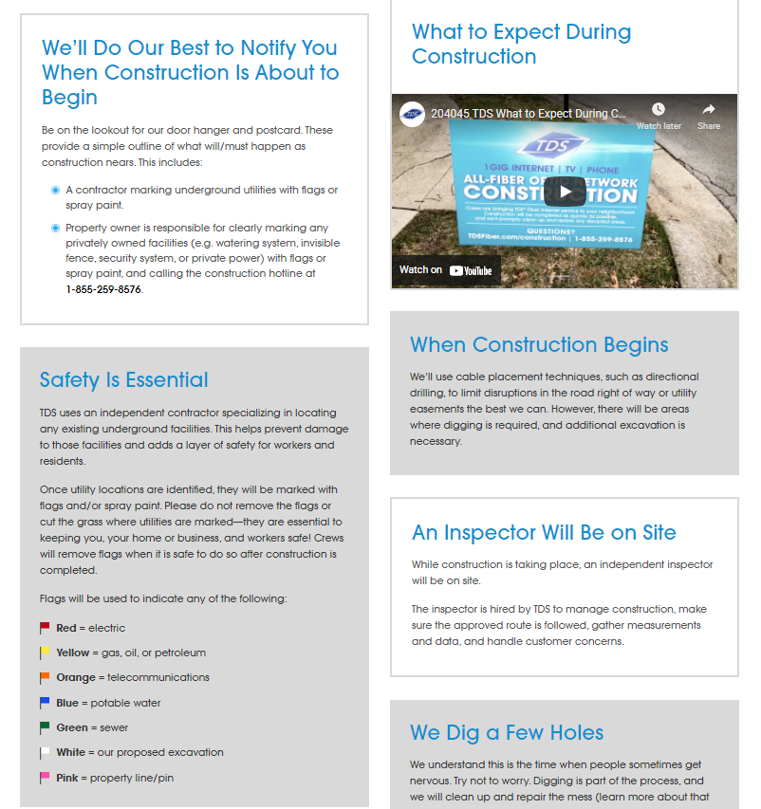

CONSTRUCTION COMMUNICATION PROGRAM
Website
Daily
Residents can be directed to tdsfiber.com/construction where they can find further information on the construction process and explainer videos.

